Slide 1
AUTOMATIC IMAGE SEGMENTATION
VIA DYNAMIC REGION MERGING
Team Noisy Pixel
Shubham Dokania (2020701016)
Shanthika Shankar Naik (2020701013)
Sai Amrit Patnaik (2020701026)
TA
Aditya Arun
Github link:
https://github.com/Digital-Image-Processing-IIITH/project-noisypixel

Slide 2
Segmentation with Region Graphs
Segmentation is a difficult problem to solve in image processing and computer vision, yet contains high potential for image understanding, analysis, and is useful in several downstream tasks. This work takes the region merging approach to segmentation. Following is the pipeline of the implementation :
We start with an initially over-segmented image with many regions (can contain vertices or super-pixels).
Formulate the image as a graph and segmentation over this graph as an optimization problem.
Iteratively merge regions according to some statistical tests.
Build the objective function and propose a solution based on dynamic programming.
Show that local segmentation using this method also satisfies global segmentation properties.

Slide 3
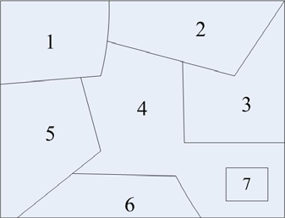
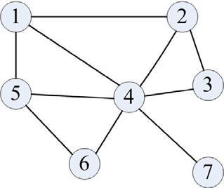
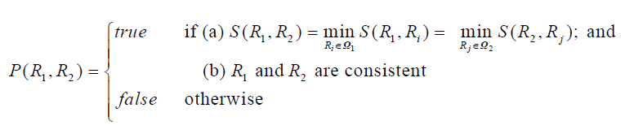
Building the Region Graph
Region Merging
Given an image, an undirected graph G = ( V , E ) , where V is set of vertices representing the pixels or regions and E are set of edges with weight given by minimum dissimilarity between two regions.
Region Adjacency Graph formation from parts of Image

Slide 4
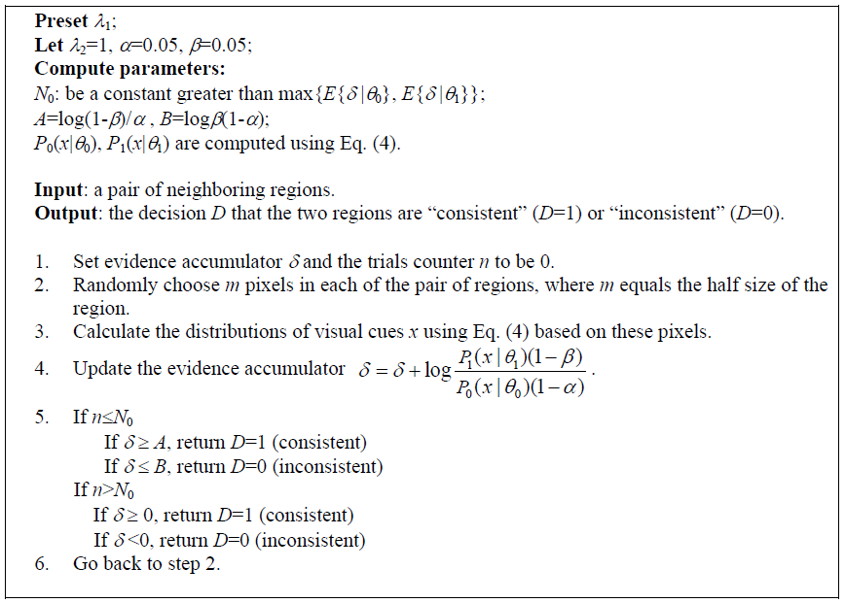
Conditions for region Merging:
Region Merging is essentially depends on:
Compatibility : Depends on the weights associated with edges of adjacent regions
Stopping Criteria: Sequential Probability Ratio Test (SPRT)
Algorithm for consistency test (The SPRT test)

Slide 5
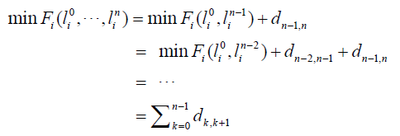
Dynamic Region Merging
As stated before, we start with an over-segmented image. We can use watershed, SLIC, or K-means based simple methods to obtain such an initial segmentation easily.
Considering the region merging as a labelling problem, we see that each region in the graph changes from an initial label to a new label on each iteration (could be same or repetitive as well), and we want to find the overall final label for these regions.
Ideally, we want to find the optimal sequence of merges which produces the union of optimal labeling for all the regions, and hence minimizes the cost of such transitions.
We define the cost for one region, based on the above assumptions as shown (left). Here, each parameter in the final sum is the cost of transition over two labels in the same region.

Slide 6
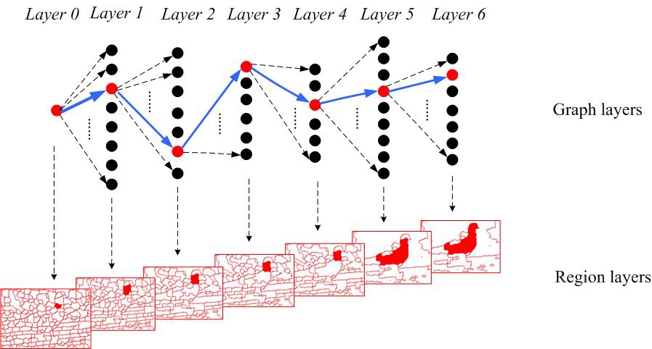
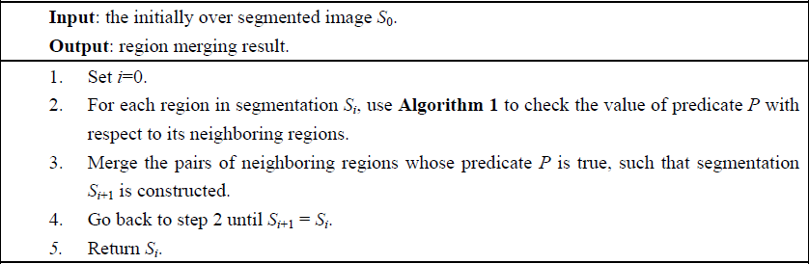
Dynamic Programming Problem
We can assume each transition as a layer in a graph, and the weight on the path to be the cost. This way, the changes happening across the entire RAG through time becomes a big graph problem where we need to find the shortest path.
And for this task, the dijkstra’s algorithm is taken into application.
Overall algorithm as a block

Slide 7
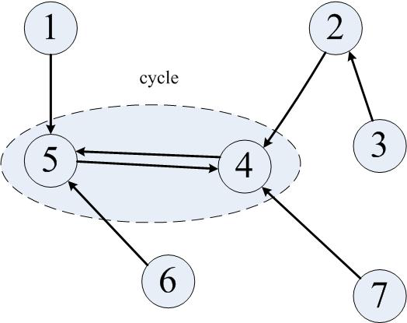
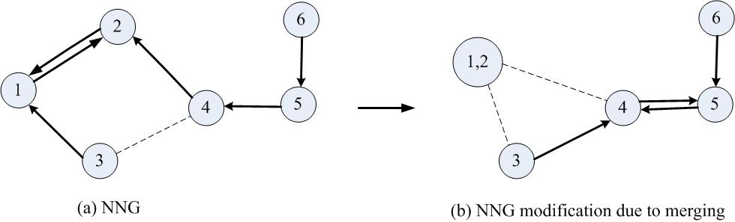
Nearest Neighbour Graph
It is easy to see that the previous algorithm has a high time complexity due to the evaluation of the minimum weights between regions for every change and requires a search over all edges at each iteration.
Such an evaluation is very slow and even for regions which have been merged, it becomes a redundant operation. To cope with this problem, the authors propose a variation to the graph which is formed by creating a Nearest neighbour alternative called the NNG (Nearest neighbour graph) (left).
The nearest neighbour graph approach (right) follows the below algorithm by merging the region nodes into one and keeping track of the weight changes. Due to this, we also notice some desirable features in the search for new regions to be merged as shown below:

Slide 8
EXPERIMENTS
Results and Analysis

Slide 9
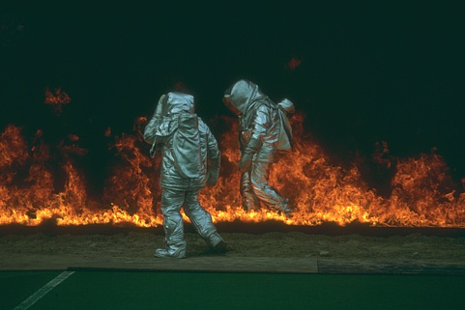



Slide 10
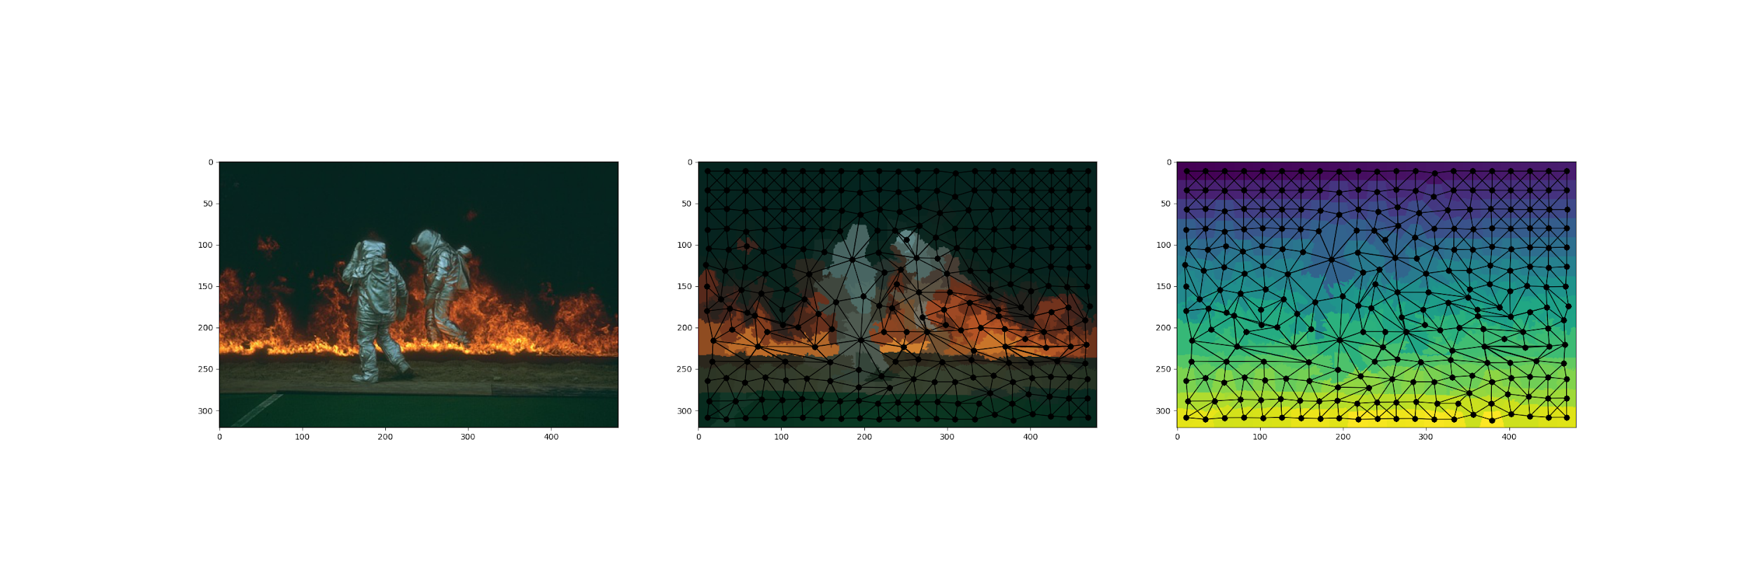
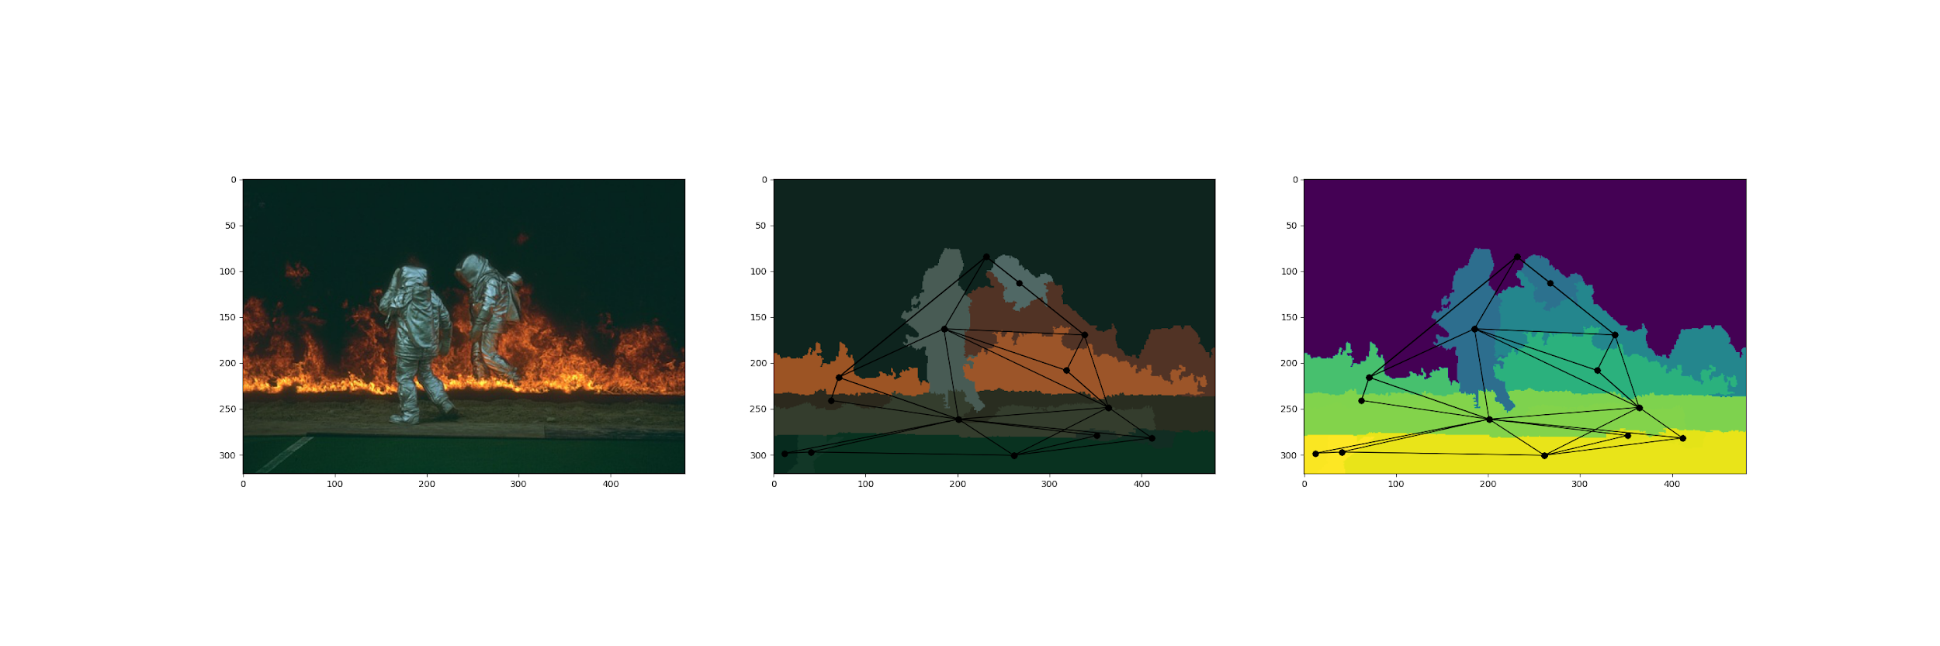

Slide 11
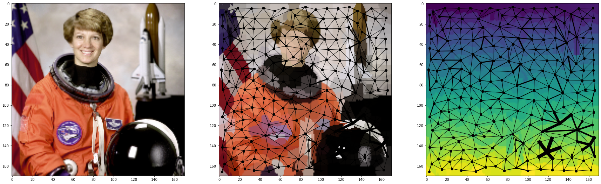

Slide 12
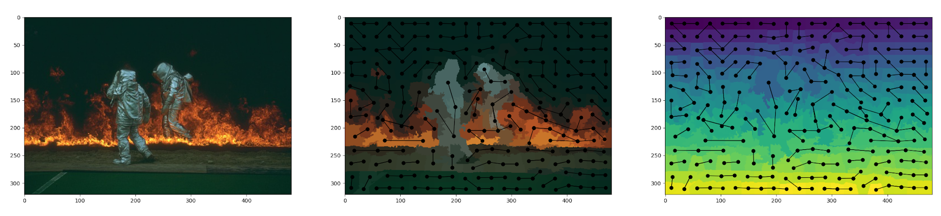


Slide 13
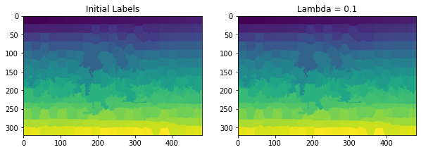
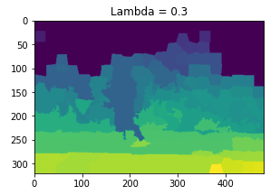
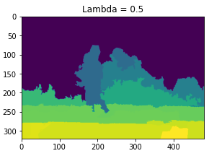

Slide 14
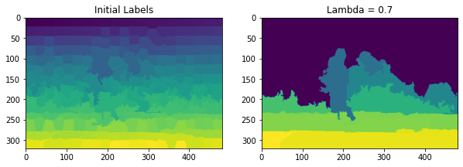


Slide 15
Division of Work
%
%
%
%
%
%
Watershed algorithm
RAG implementation
SPRT Test
Dynamic Region Merging
NNG for Region Merging
Results
Shanthika
Shubham
Sai Amrit
Shubham
Shanthika Shubham
Sai Amrit

Slide 16
Thank You
Fin.

